Slide 1



Analysis of Hospitality Trends in Melbourne

Slide 2

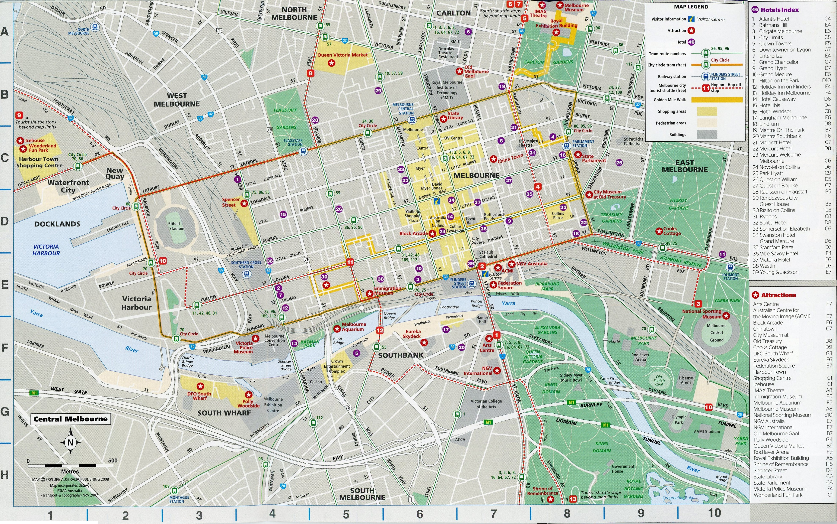
Deep Dive Analysis of Statistics Within Hospitality Between 2002 to 2020

Slide 3

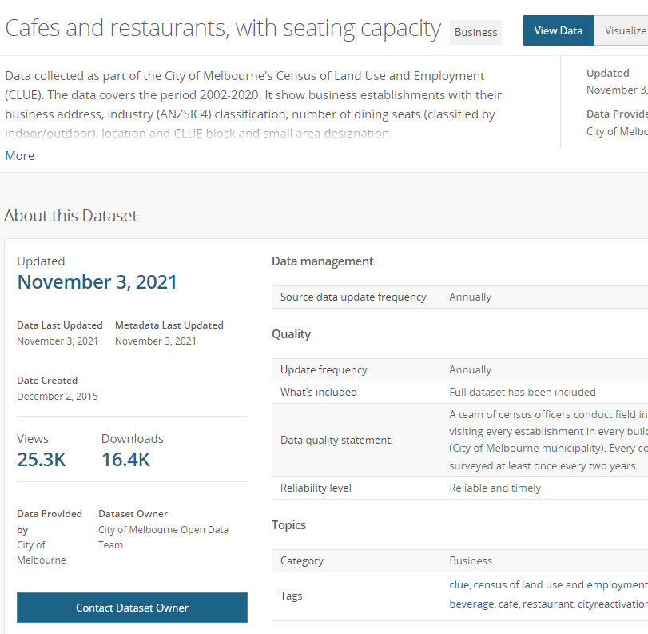
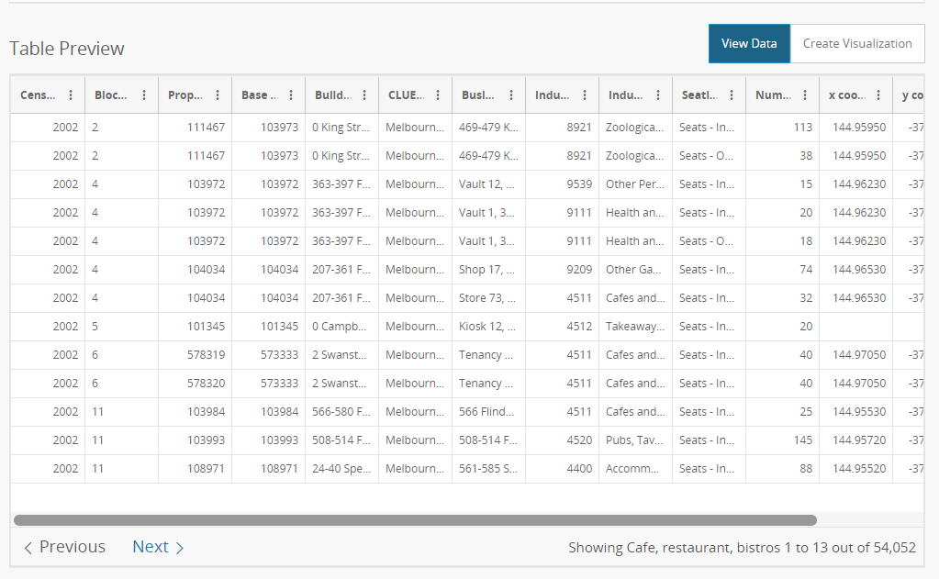
Dataset
https://data.melbourne.vic.gov.au/Business/Cafes-and-restaurants-with-seating-capacity/xt2y-tnn9

Slide 4
Who are we this data building for ?
Prospective Hospitality Owners/ Managers, eager to better understand the Melbourne Market
Which suburbs should & shouldn’t I open a Café, Bar or Takeaway venue and why ?
What have been the trends/ patterns over the past 20 years ?

Slide 5
What is the problem we are solving ?

Slide 6
Explanatory Data Analysis and Infographics

Slide 7
Average Sitting per suburb over the timespan – Dhiren

Slide 8
Indoor vs. Outdoor Seating Availability Trends – Rosa

Slide 9
Opening vs. Closing Trends within the Dataset – Michael

Slide 10
Comparisons on each of the industries over the years – Brandon

Slide 11
Limitations with current study
Data only included suburbs within Melbourne’s CBD
Of the 69 different industries: Café’s and Restaurants comprised 74.8% of the Data
Furthermore, 4/69 categories comprised 96.49% of the data, the remaining 65/69 needing to be consolidated

